Slide 1

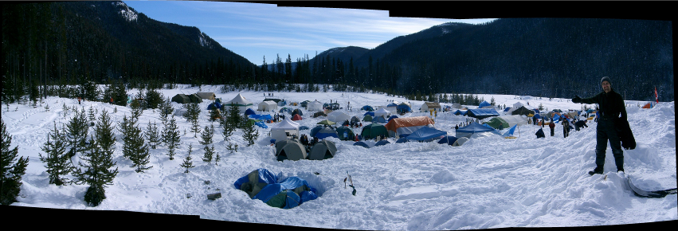
Cold Talk
January 3, 2023
Notes:
Welcome

Slide 2

Rovent - The Main Details
Who – Venturers, Rovers, Rangers and Link (Don’t forget your advisors)
What – Winter Camp
Where – Manning Park
  Cambie Creek
When – February 17 – 20, 2023
Why – Because it is lots of fun and shouldn’t be missed
Notes:
Gloss over this

Slide 3
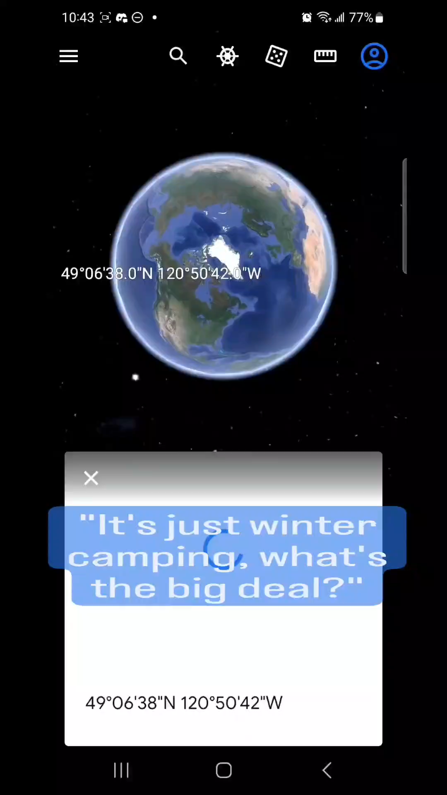

Slide 4
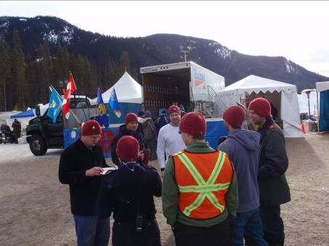
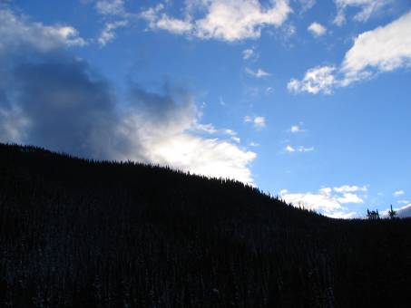
What To Expect
Weather - Sun, Cloud, Rain, Snow, Wind
Site – open space with trees under the snow
People – great fun to spend time with
Activities - lots of fun

Slide 5
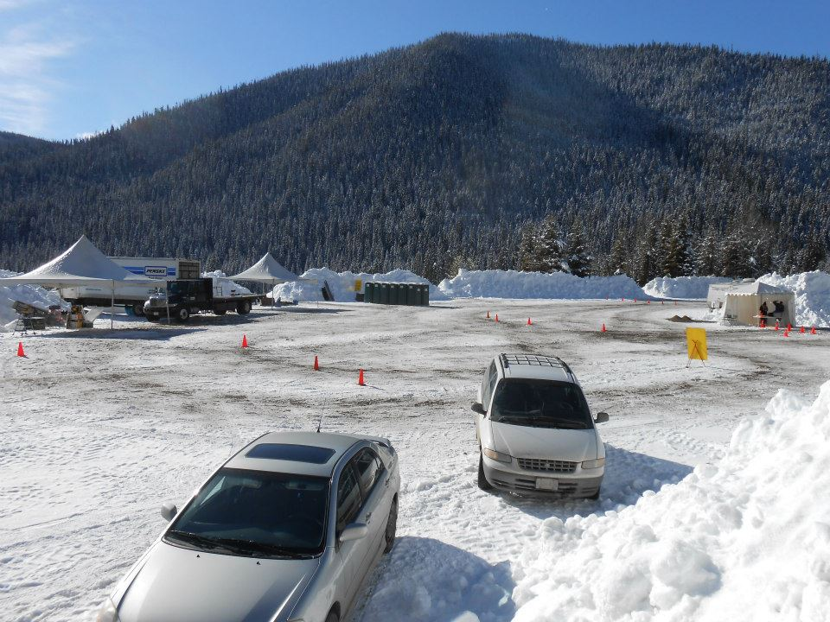
When You Get There?
Registration
( More next slide)
Parking
Trailers
Notes:
2 things you need to know about parking and vehicles at camp.
Parking at Rovent is done Dead lot style. First In = Last out
If you will only be staying with us for a short period and need to leave before Monday morning you NEED to park in our off site lot.
Trailer are only allowed nsite during loadin and loadout periods. No trailers are allowed to stay in the onsite lot. How many people have been walkign or hiking at night and bumped their shin or toes on a low branch? This is one thing we are avoiding by doing this the other allowing for a faster clearout of the parking lot.
\

Slide 6
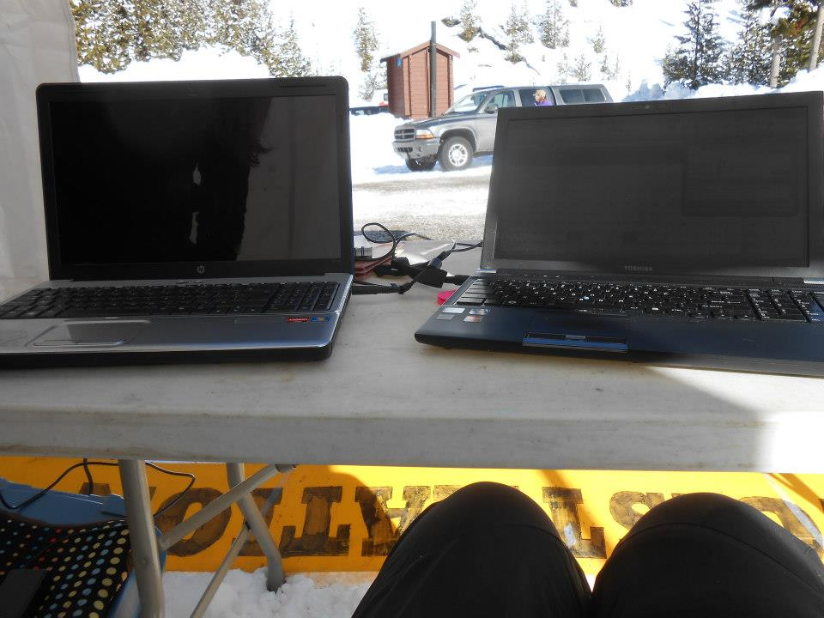
Registration!
Know your group name.
MUST be a registered member of your organisation.
MUST have a paper copy of your registration AT THE REGISTRATION TENT
  SC – Group summary printout
  GGC iMis Unit Roster - Basic Report

Slide 7
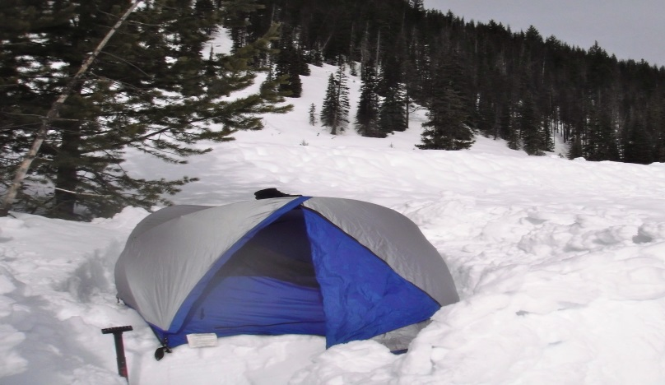
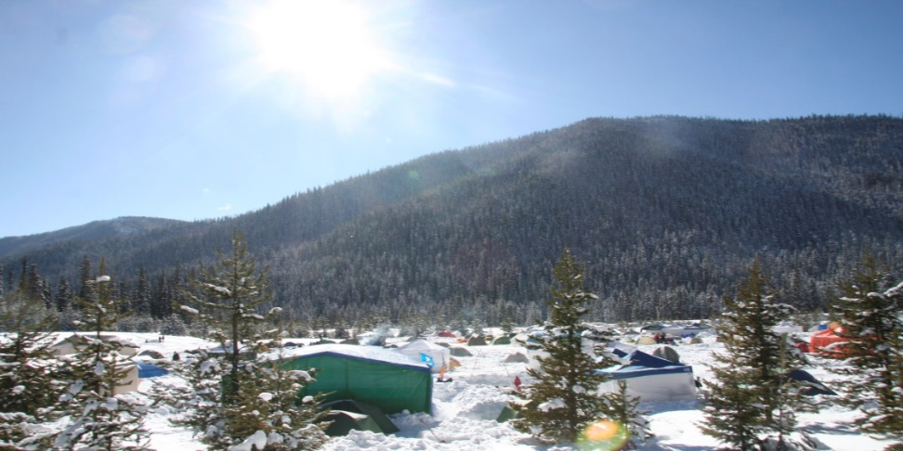
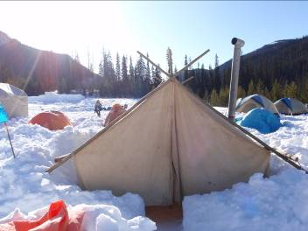
Where will I stay? What do I need to set it up?
Tents Vs Shelters Vs Snow Caves
  Shovels, tarps, pegs
Heaters, fires, other heat sources

Slide 8
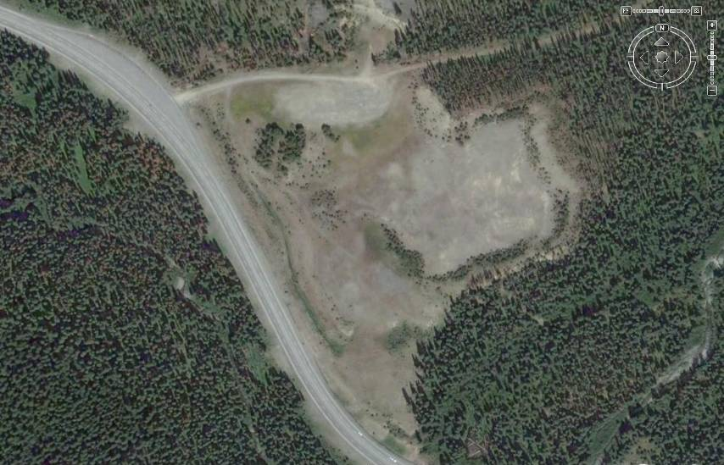
Where can I go?
Notes:
-Stay withing the parking lot – Field area
-Stay away from the exposed hill to the north side of parking lot
-Beyond the trees to the south is steep embankment into a gully
-Stay off the berm leading to the highway on eh west

Slide 9
Rovent’s Potential Dangers
Carbon Monoxide Poisoning
Dehydration
Hypothermia
Frostbite
All First Aid is done by trained volunteers
Supervised by BCEHS Paramedics who are also Scouters

Slide 10
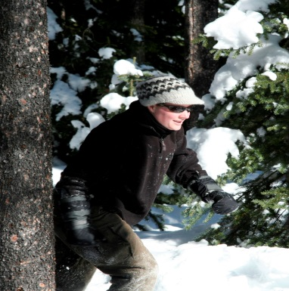
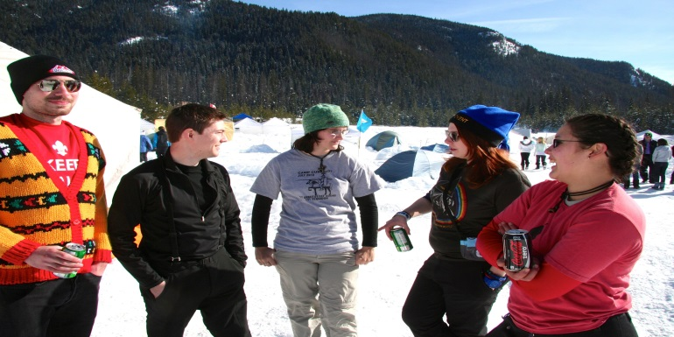
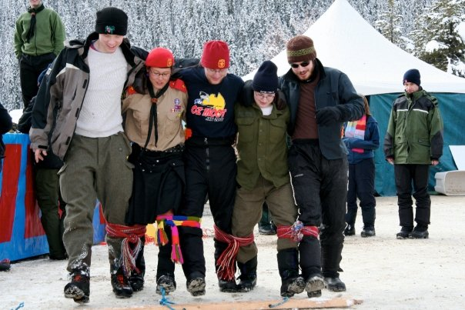
What should I wear?
Underwear
Base layer
Warm layer
Fleece
Outerwear
Hats, hats, hats!
Make sure it’s dry
NO JEANS

Slide 11
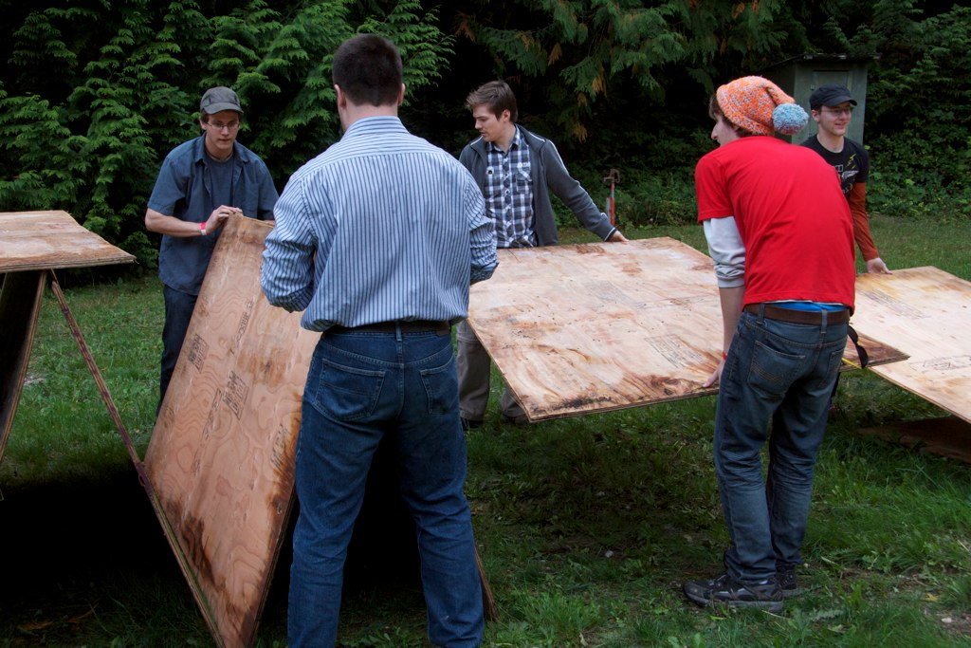
Rovent’s what not to wear
NO JEANS
Running Shoes
Yellow Plastic Rain Gear

Slide 12
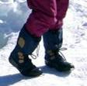
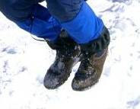

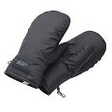
What about my hands and feet?
Gloves Vs Mittens
Socks
More Socks
And More Socks
Shoes Vs Boots
Gators and crampons
Plastic Bags??? Why or why not

Slide 13
Bed time?
What to wear What to Sleep in/on
A whole new set
Not to be worn at any other time then bed time
Keep them dry
Have an extra hat
Foamy (NO AIR MATTRESSES)
Sleeping bag (maybe two)
Blankets
Reflective material

Slide 14
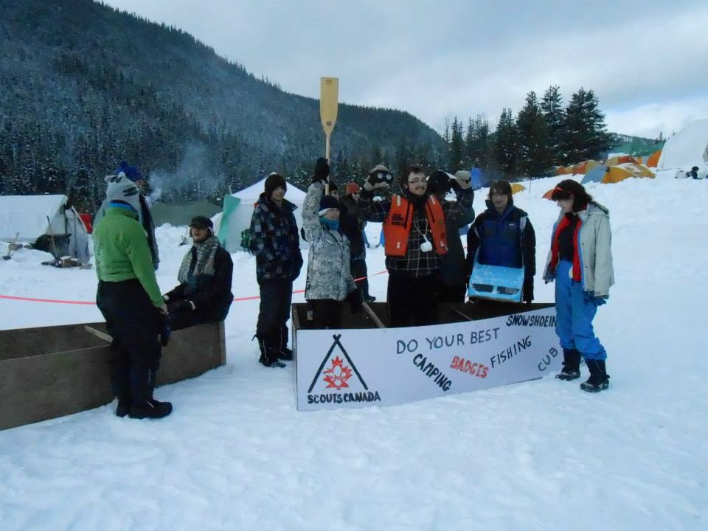


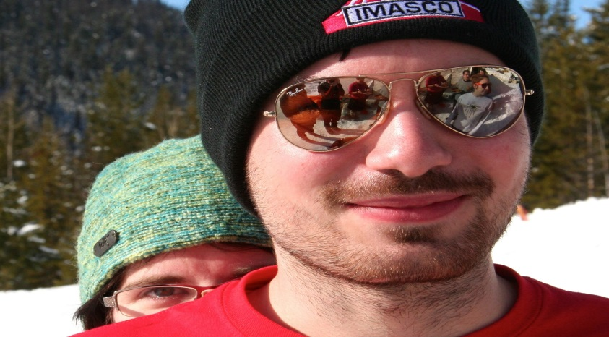
6 weird things to bring to camp
Sunglasses
Sunscreen
Lip balm
Kleenex
Moisturizer
Hand cream

Slide 15
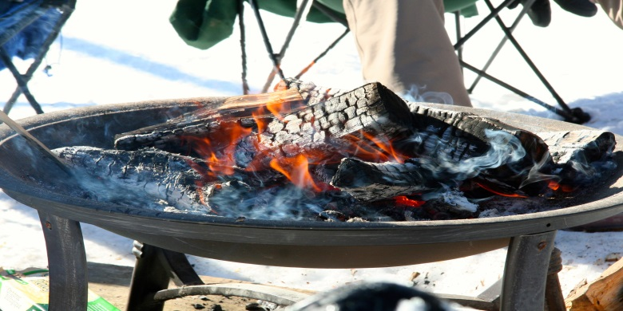
What do I do if I’m cold?
Put on a hat
Go pee
Go for a walk
Change your socks
Have something to eat
Still Cold?
Find a warming shelter or fire
Talk with MAST
Notes:
Hat, pee, walk, socks, eat.
Warming shelter then mast

Slide 16
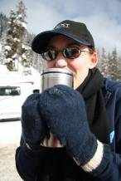
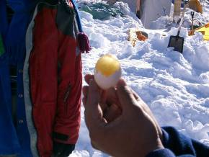
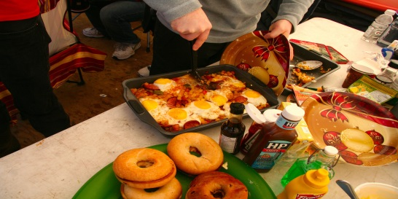
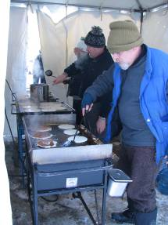
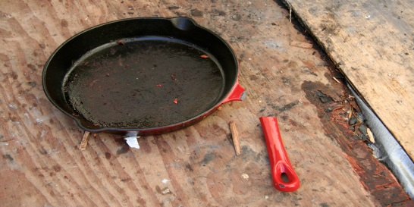
What should I eat?
Balanced diet
Lots of liquids: hot and cold
Water
Snacks
Eat before bed
How should I cook it?
  However you like.

Slide 17
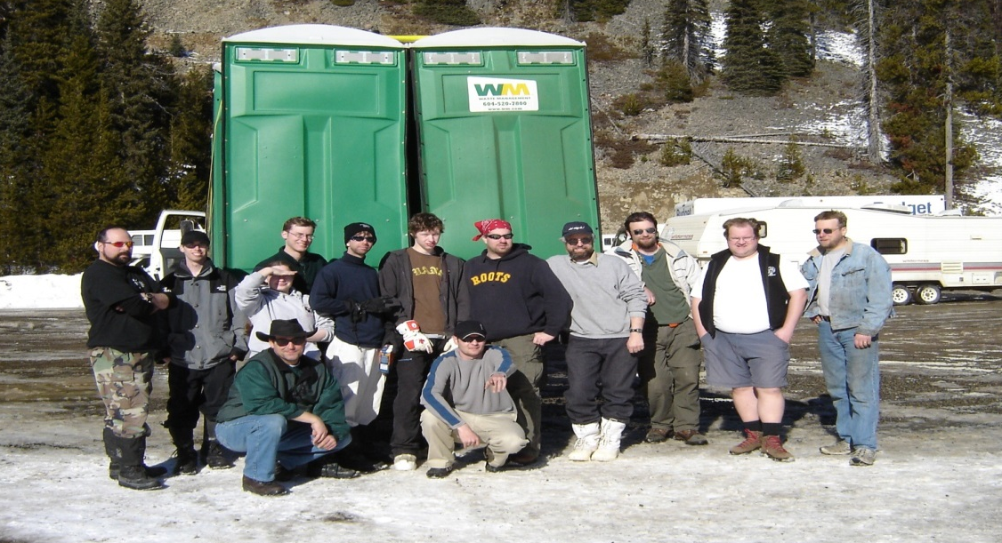
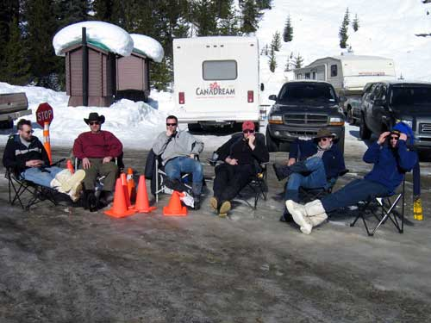
What if I have questions at camp?
Ask the hard working staff

